Slide 1

Angular 教育訓練
Grady Liu

Slide 2
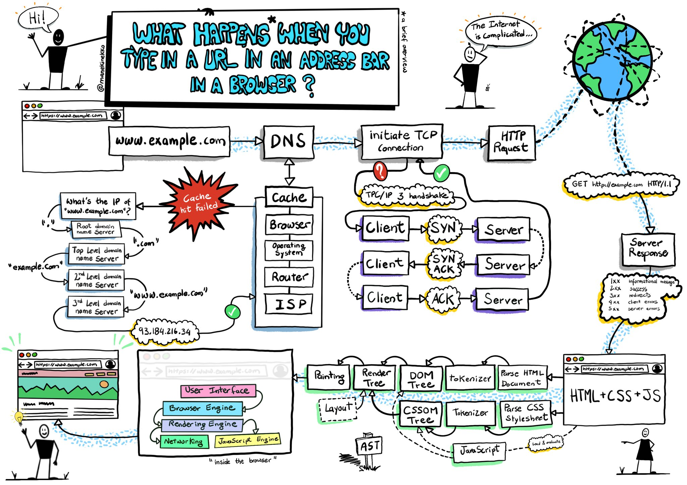
https://twitter.com/manekinekko/status/1281704000572858375/photo/1

Slide 3
Agenda
What is Angular
Core Concepts
Angular CLI Component Data Binding Directive Service (Dependency Injection) HTTP Client
Q&A

Slide 4
課程參與
線上編輯器
https://stackblitz.com/~/github.com/grady982/angular-training
本機開發環境 Prerequisite - VS Code - Angular CLI 16 - NodeJs 16.14.0
課程 source code https://github.com/grady982/angular-training.git

Slide 5
What is Angular ?
Angular is a development platform, built on TypeScript.
https://angular.io/guide/what-is-angular
Understand Angular Version
AngularJS(Angular 1) — complete re-write → Angular(Angular 2 … latest)

Slide 6
Core Concepts

Slide 7
Core Concepts
Angular CLI
Component
Data Binding
Directive
Service (Dependency Injection)
HTTP Client

Slide 8
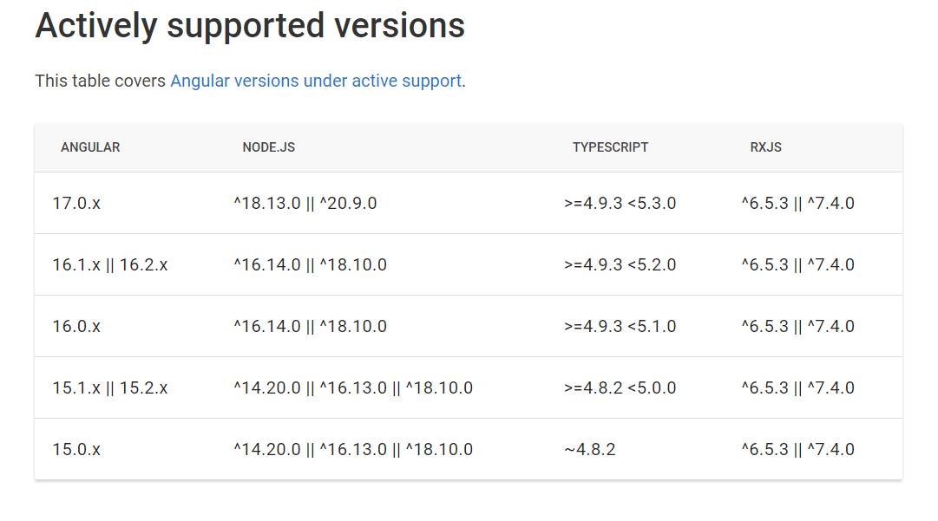
Angular CLI
The Angular CLI is a command-line interface tool that you use to initialize, develop, scaffold, and maintain Angular applications directly from a command shell.
https://angular.io/cli
npm I -g @angular/cli@16.2.11
Notes:
npm I -g @angular/cli@16.2.11 ng --help ng new –help ng new my-first-project cd my-first-project ng serve ng build my-app -c production
ng generate component my-first ng g c my-second ng g environments

Slide 9
Component
Angular 資料夾結構
Create Component
Component Lifecycle
Component Communication

Slide 10
Create Component
已 Angular CLI 建立 Component
已手動建立 Component

Slide 11
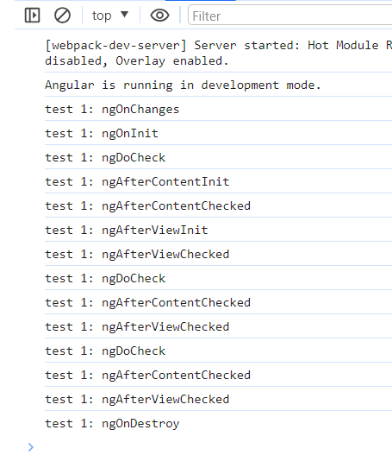
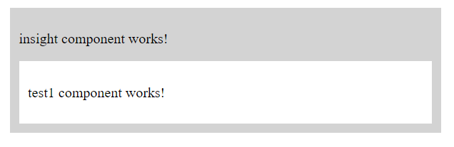
Component Lifecycle
ngOnChanges() ngOnInit() ngDoCheck() ngAfterContentInit() ngAfterContentChecked() ngAfterViewInit() ngAfterViewChecked() ngOnDestroy()
Notes:
ngOnChanges() 如果有綁定資料會在 ngOnInit之前執行, 以及每次綁定資料變更時觸發執行。 ngOnInit() 載入時執行一次 ngDoCheck() 變更偵測被觸發時執行 ngAfterContentInit() 載入時執行一次 ngAfterContentChecked() 在 ngAfterContentInit 後執行，並在每次 ngAfterViewInit() 載入時執行一次 ngAfterViewChecked() ngOnDestroy() 在 component 被 destroy 前執行

Slide 12
Data Binding
What is Data Binding?
According to the business logic dynamically to bind the data int to the template(HTML). Types of data binding
String Interpolation {{ expression }} One-way from data source to view target
Property Binding [target] = “expression” One-way from data source to view target
Event Binding (target) = “statement” One-way from view target to data source
Two Way Binding [(target)] = “expression” Two-way
簡單來說 (Expression)表達式用於生成一個值，而 (Statement)語句用於執行一個操作

Slide 13
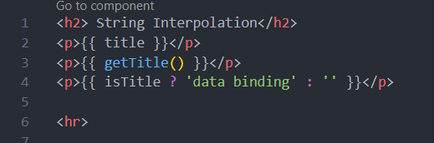
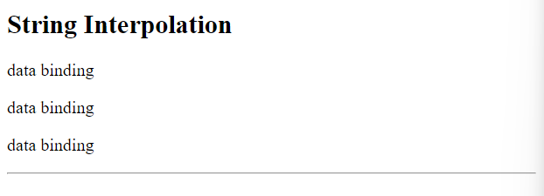
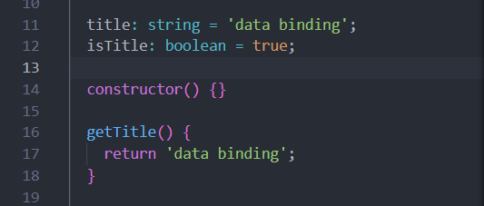
String Interpolation
{{ expression }} you can write ternary, variables and function … etc then Angular will resolve the result to a string at the end.

Slide 14
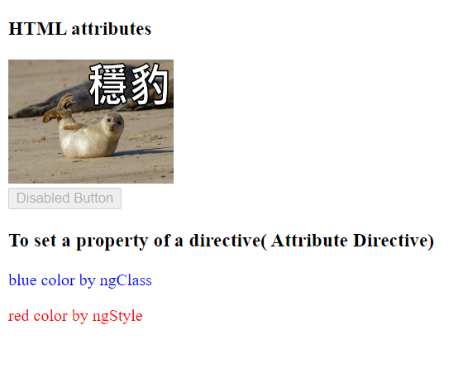
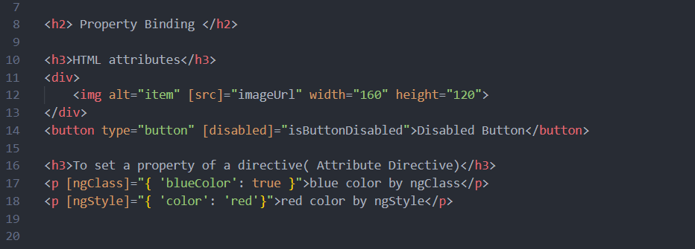
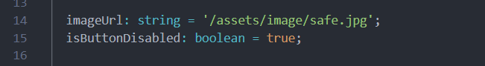
Property Binding
[property]="expression" indicate Angular which of native DOM property you want to dynamically bind value. Property binding moves a value in one direction, from a component's property into a target element property.

Slide 15
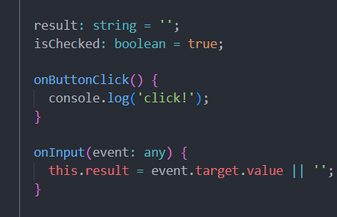
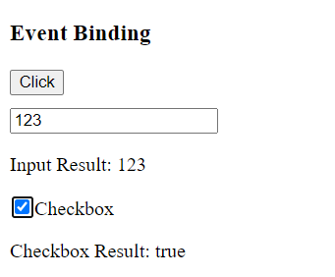
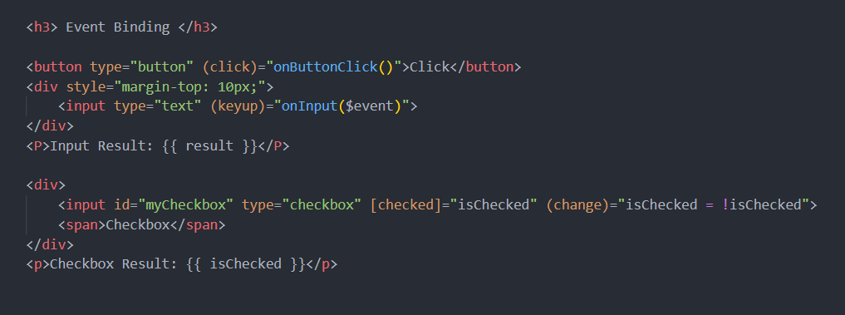
Event Binding
(event)=“expression” Event binding lets you listen for and respond to user actions such as keystrokes, mouse movements, clicks, and touches.
$event is kind of reserved variable which fire by DOM when events occur that’s how we access the event data.

Slide 16
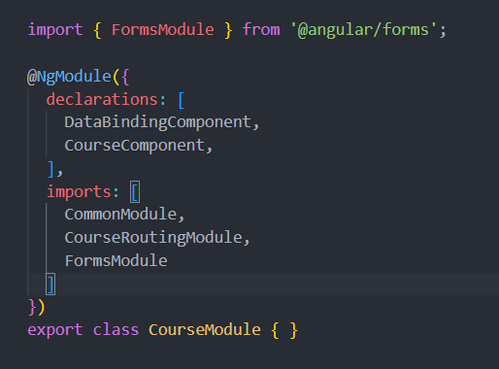

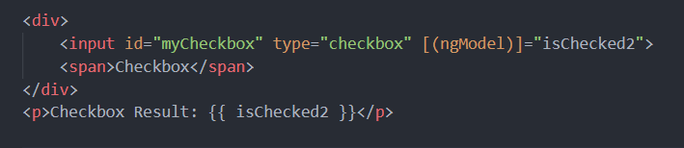
Tow Way Binding
Combine property and event binding. It will trigger update the variable’s value and element’s value.
[(ngModel)] FormsModule is required for two-way binding. That’s mean you need to enable the ngModel directive by add FormsModule in the AppModule.

Slide 17
Directive
What are Directives?
Directives are classes that add additional behavior to elements in your Angular applications. Simply put is instruct Angular how to manipulate the template.
1. Built-in Directive
2. Custom Directive

Slide 18
Built-in Directives
Use Angular built-in directives to manage forms, lists, styles, and what users see.
Structural Directives Change the DOM layout by adding and removing DOM elements.
Attribute Directives Never change the DOM from element. Only change properties from that element. Look like a normal HTML attribute(possibly with data binding or event binding) Only affect/change the element they added to
https://angular.io/guide/built-in-directives
Notes:
在開始之前可以先了解一下位甚麼需要前端框架 jQuery + Bootstrap不好嗎？為啥冒出像是React、Angular、Vue這種東東？ 具體來說，前端框架幫我們處理了什麼？ 簡單用四個項目做說明
元件 一些可以複用且又各自獨立的 UI，如 Button,Dialog 單靠純原生的 HTML, CSS, JS 要去做到 Component 的概念很麻煩，而藉由框架，我們可以很快地去撰寫 Component，幫助我們複用程式碼、加速開發也提升開發者體驗 狀態管理 State Management 主要管理 資料 和 使用者操作事件 的互動流程 像是會員系統會有訪客和會員兩種狀態，而訊息也會有已讀跟未讀兩種狀態等等，因應網站的複雜度，你在整個網頁應用程式中，也會有很多的狀態需要去管理 路由 Routing 主要是前端處理頁面之間的導航、切換可以有一個統一且有效的控管 生命週期 框架在瀏覽器上運作的流程，幫我們處理 DOM 和 瀏覽器渲染機制 簡單來說，框架帶來的好處就是可以有更好的開發者體驗 和提供各種好用的工具

Slide 19
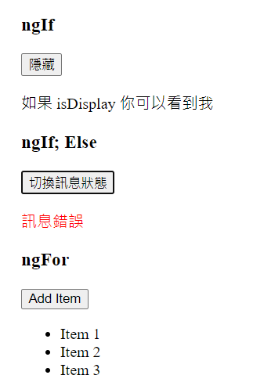
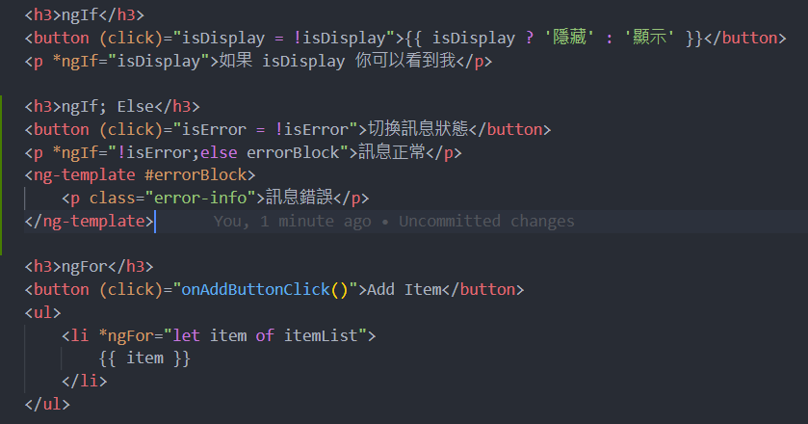
Structural Directives

Slide 20
Attribute Directives
Attribute directives listen to and modify the behavior of other HTML elements, attributes, properties, and components. The most common attribute directives are as follows:
ngClass Adds and removes a set of CSS classes CommonModule
ngStyle Adds and removes a set of HTML styles. CommonModule
ngModel Adds two-way data binding to an HTML form element. FormsModule

Slide 21
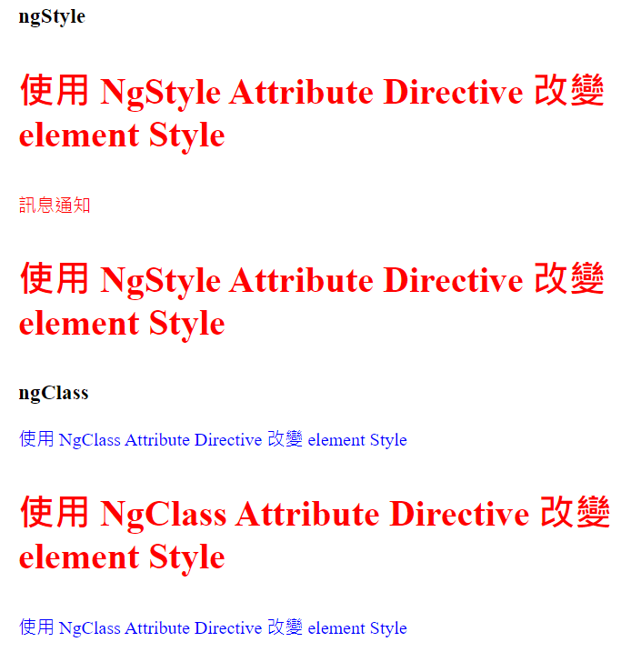
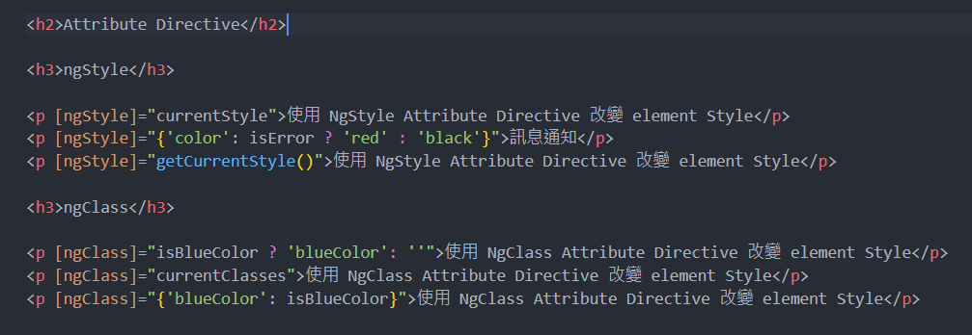
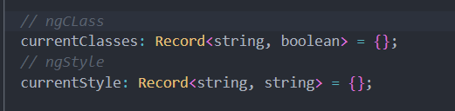
NgClass & NgStyle

Slide 22
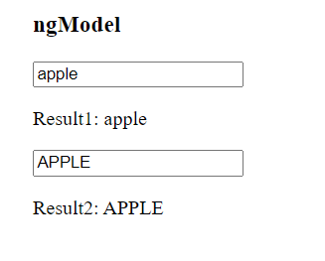
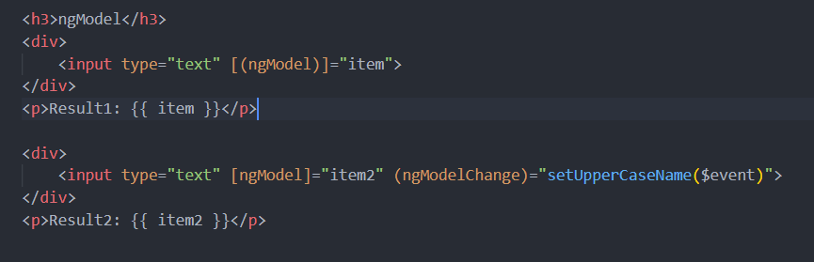
NgModel

Slide 23
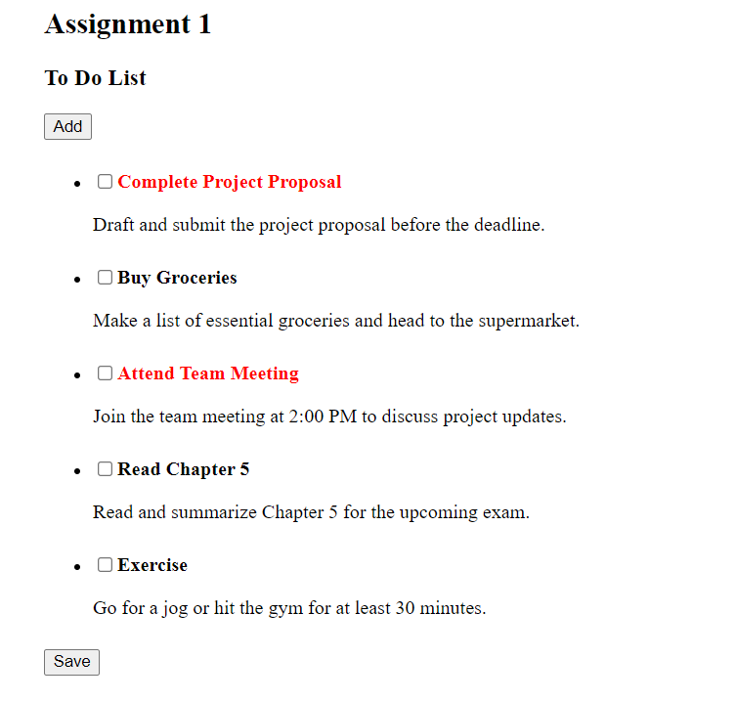
Assignment: To-Do List

Slide 24
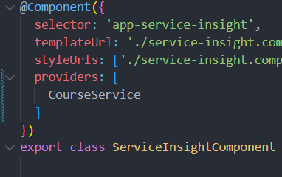
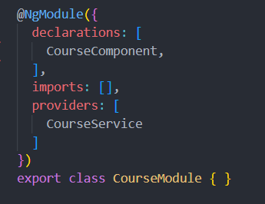
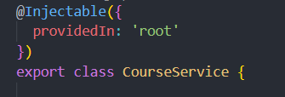
Service & Dependency Injection
Depenedency injection 簡稱 DI 這是一個 design pattern 與機制，已注入的方式來取得服務的 instance 做使用。 DI System 有兩個主要的腳色: Dependency Consumer、Dependency Provider
Provider 層級
Component Level Application Level Root Level

Slide 25
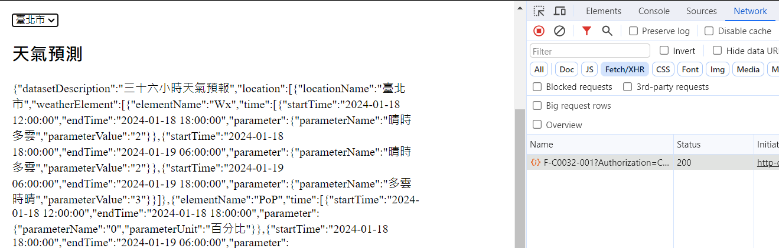
HTTP Client Service
透過 HTTP protocol 與後端溝通，此章節帶你認識與使用 Angular 框架提供的 HttpClient service

Slide 26
Q & A

Slide 27
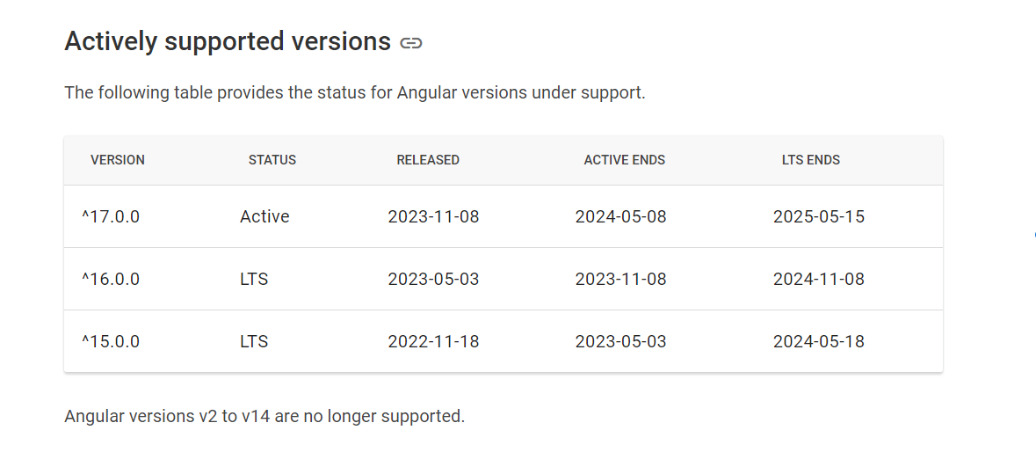
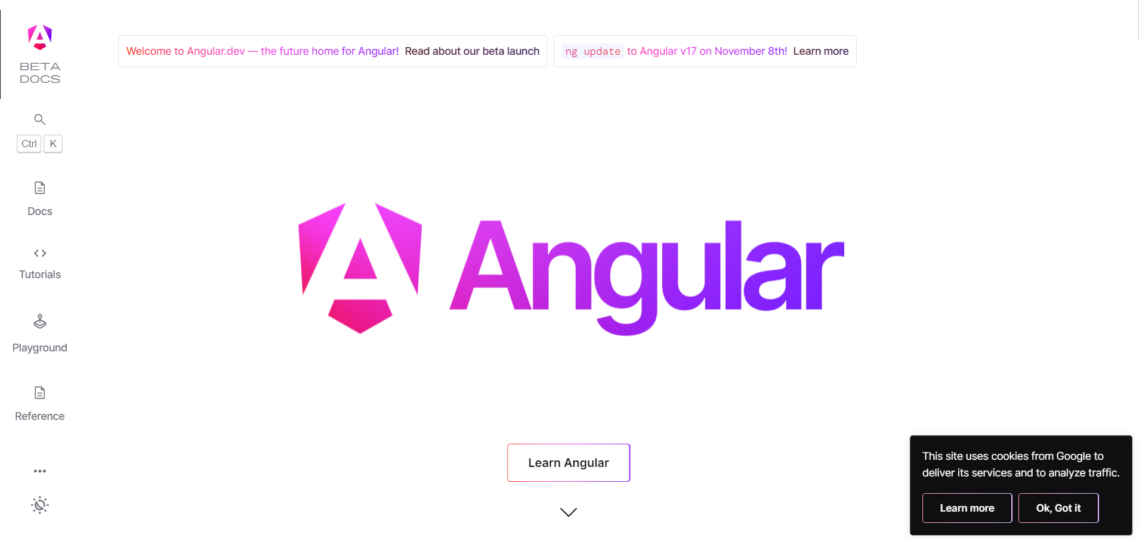
Special Angular Event
Angular v17 release🎉🎉🎉
The future home for Angular

Slide 28
Thank You

Slide 29
DOM
**文件物件模型（Document Object Model, DOM）**是 HTML、XML 和 SVG 文件的程式介面。它提供了一個文件（樹）的結構化表示法，並定義讓程式可以存取並改變文件架構、風格和內容的方法。DOM 提供了文件以擁有屬性與函式的節點與物件組成的結構化表示。節點也可以附加事件處理程序，一旦觸發事件就會執行處理程序。 本質上，它將網頁與腳本或程式語言連結在一起。
雖然常常使用 JavaScript 來存取 DOM，但它本身並不是 JavaScript 語言的一部分，而且它也可以被其他語言存取（雖然不太常見就是了）。
https://developer.mozilla.org/zh-TW/docs/Web/API/Document_Object_Model

